Slide 1


EXPLORATORY DATA ANALYSIS (EDA)
ON
TITANIC DATASET

Slide 2
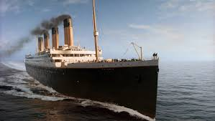

Introduction
• EDA (Exploratory Data Analysis) is an approach to analyzing datasets to summarize their main characteristics.
• Dataset: Titanic Sample Dataset (500 rows)
• Goal: Understand structure, handle missing/duplicate values, gain insights.

Slide 3




Goals of the Analysis
Explore the dataset structure and values.
Summarize statistical and categorical data.
Identify and handle duplicates and missing values.
Gain insights related to passenger survival.

Slide 4
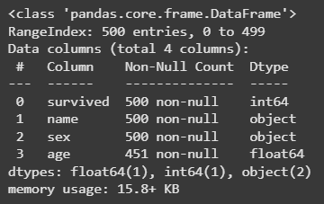
Initial Data Exploration
Used .head(), .tail(), .sample(), and .info() to view dataset.
Columns: survived, name, sex, age.
500 rows × 4 columns.

Slide 5

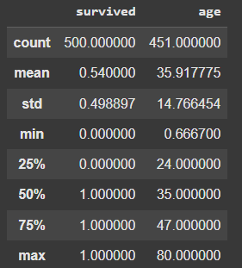


Statistical Summary
Average Age: ~35.9 years (Min: 0.67, Max: 80)
Gender Count: 288 Males, 212 Females
Survived: ~54% of passengers

Slide 6

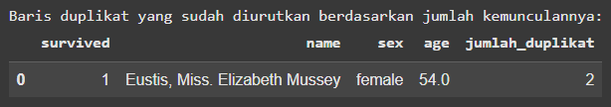
Handling Duplicates
Detected 1 duplicate row.
Duplicates were removed.
No more duplicates after cleaning.

Slide 7
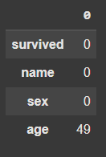
Handling Missing Values
Missing values found in 'age' column: 49 rows (~9.8%)
Missing values filled using median imputation.

Slide 8
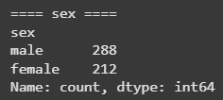
Insights
More males than females in the dataset.
Survival rate is around 54%.
Name column contains titles (Mr., Miss., etc.) which can be used for feature engineering.
Wide age distribution, may affect survival.

Slide 9
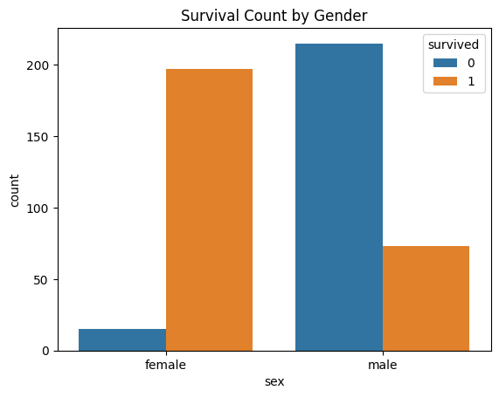
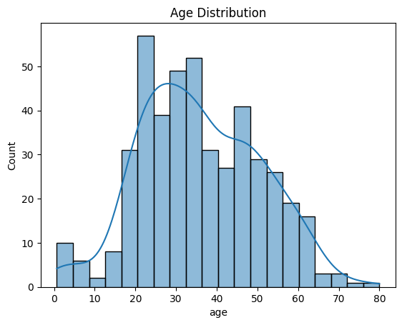

Slide 10
Advice for Future Work
Extract titles from 'name' for better features.
Impute age based on groupings like gender/title.
Create visualizations to explore relationships further.
Build simple prediction models (e.g., Logistic Regression).

Slide 11

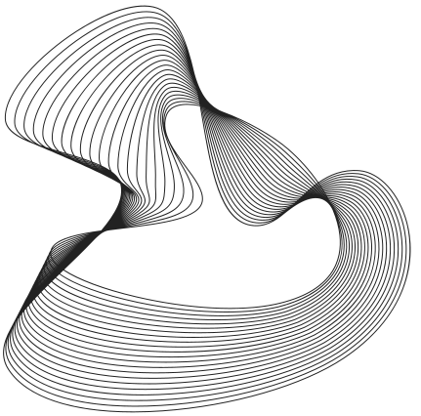

Thank You
Contact Us
helenpatricia061006@gmail.com
www.linkedin.com/helenptrcia
Gerente General

